Slide 1




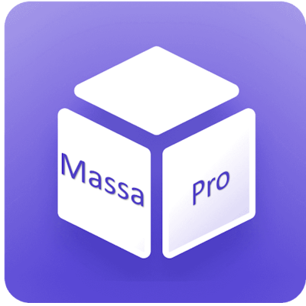


MassaPro Conversational Platform
AI Native Omni-channel Platform
massapro.com

Slide 2
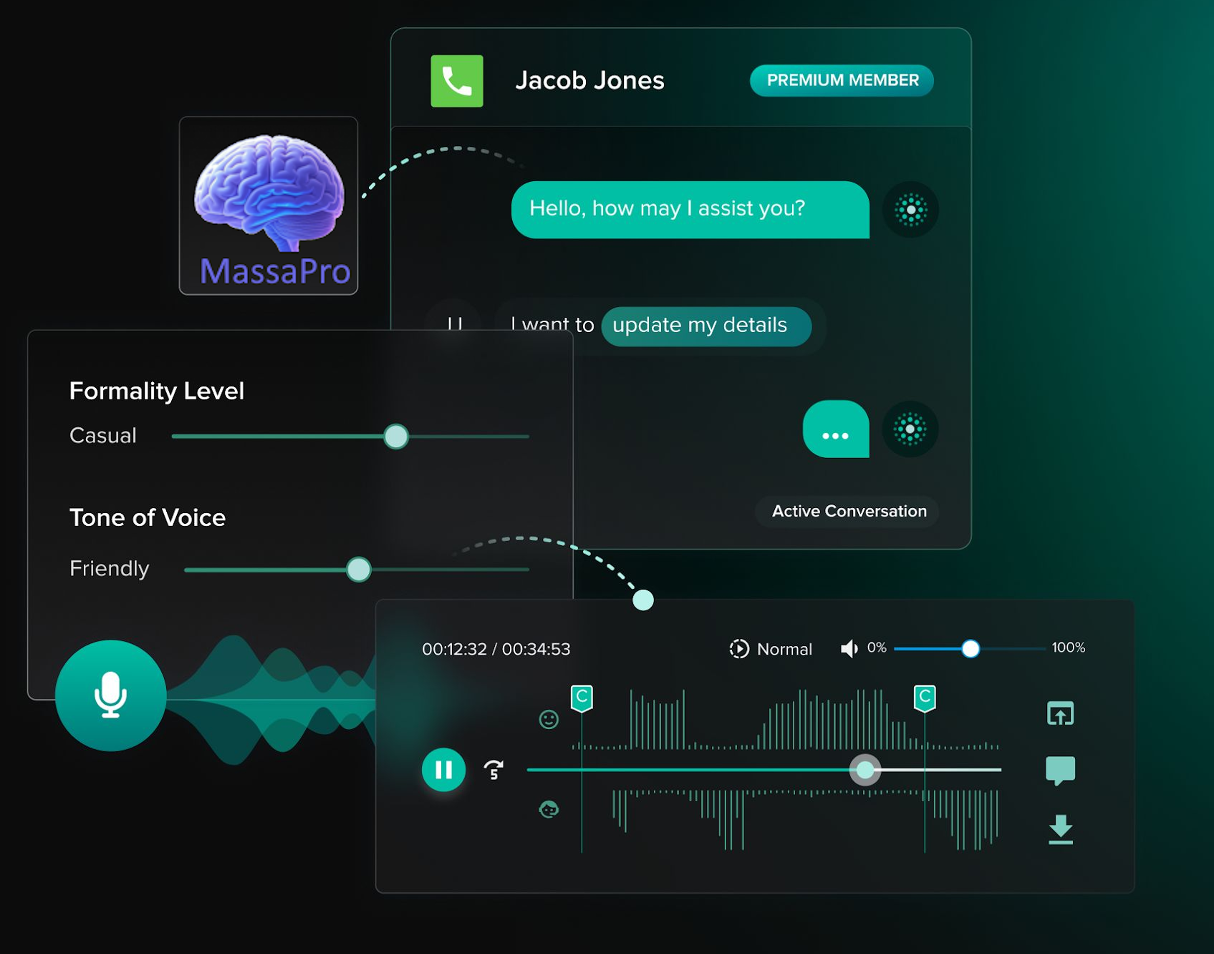






Human-AI Automation That Scales Revenue
Harness the power of Human-AI to work smarter, scale faster, and innovate boldly using custom automation & intelligent sales solutions.
One intelligent agent for 24/7 sales & retention
Omni-channel coverage across all platforms
Real-time measurable impact on growth
Flexible models, fully managed to SaaS.
TRUSTED BY BIG BRANDS WORLDWIDE

Slide 3











The Gen AI Paradox: Why 80% Adopt AI, Yet Only 20% See Impact?
Despite widespread adoption, generative AI has delivered minimal bottom-line impact for most organizations.
Nearly 8 in 10 companies report using Gen AI
Yet a similar percentage indicate no material contribution to earnings
Democratized access to AI capabilities, but transformative power remains largely untapped
Adoption
Impact
~80%
~20%
Fine-Tuned Precision
MassaPro.com
Data Source: McKinsey report on Agentic AI, download it here

Slide 4


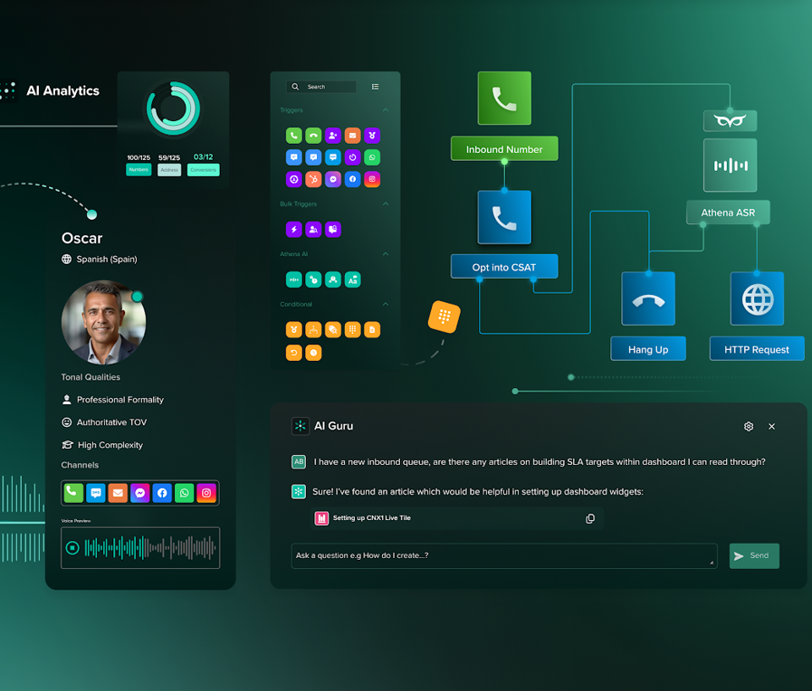





MassaPro Services
Omni-channel platform
Customer Support & Sales
We provide a fully managed omni-channel conversational solution, that plans, integrates, deploy, analyzes, optimizes, scale, set-up flows & journeys, with localized multi-language capabilities
Security Above All
Your data is protected with enterprise-grade security measures, including encryption and regular audits, ensuring maximum safety.
Centralized hub
Provide customers a coherent experiences across all channels you communicate on. With’ MassaPro AIs Omni centralized hub, users experience a continuous conversations.

Slide 5
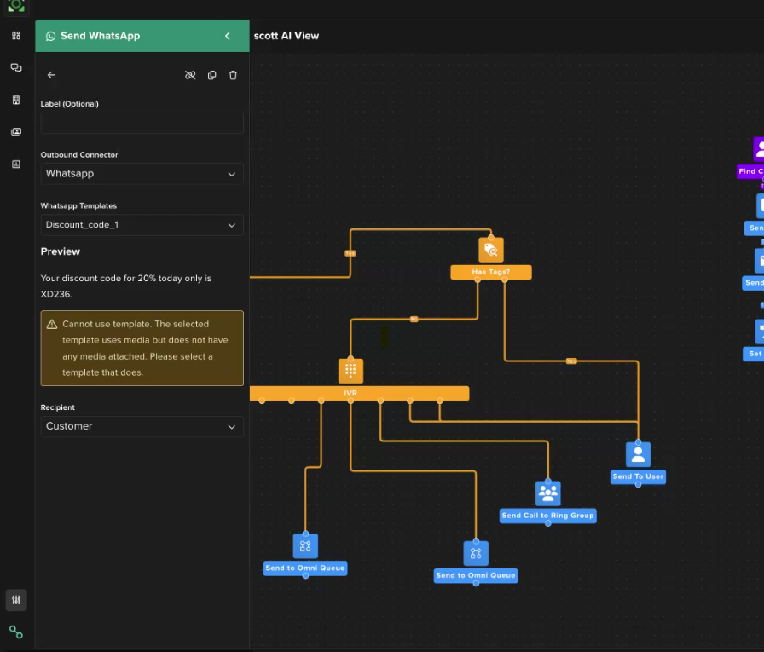





MassaPro Services
Journey & optimization
AI Marketing Automation
We provide a fully managed solution, that plans, integrates, deploy, set-up flows & journeys, analyzes, optimizes and scale omni-channel conversational teams.
Humanized AI Agents
AI customer interactions with refined, human-like voice and text-based communication, setting a new standard beyond traditional chatbots and driving unparalleled business success.
Continuous Optimization
Always-on improvement, while optimizing directly against your sales conversion rates and customer support KPIs and matching real customer phrases to journeys, boosting accuracy.

Slide 6


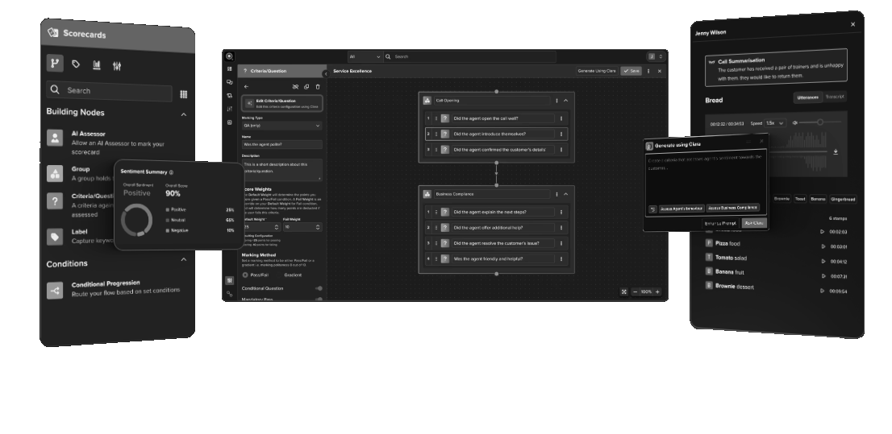






Centralized Cross-channel Communication
Fully Managed Conversational AI
MassaPro Large Language Model
AI Agent
Owned & unique MassaPro LLM focused on delivering humanized customer support and sales services.
Automate customer interactions, streamline communication and improving overall customer satisfaction by ensuring swift and accurate responses to customers through any channel.
AI Guru
MassaPro Voice
AI Guru is your revolutionary internal assistant, designed to boost productivity. Transform how teams interact with customers, offering instant access to practical knowledge and unparallelled support.
Foster humanistic interactions with AI Voice, improving customer satisfaction with intelligent text-to-speech assistance that is tailored to your brand’s tone of voice, formality, and language requirements.
AI Analytics
Automatic Speech Recognition
Gain a holistic view of customer support across all channels. AI Analytics empowers leaders with data-driven insights to refine strategies, enhance decision-making and streamline business processes.
With 99% accuracy, ASR can scale to handle varying call volumes without the need for additional staff. Easily manage staff during peak times or in response to specific events that lead to increased call traffic.

Slide 7


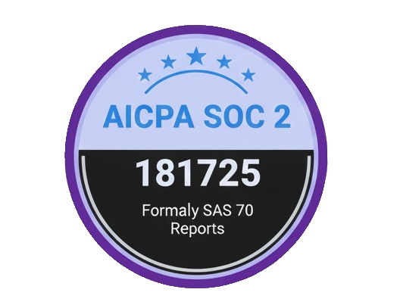
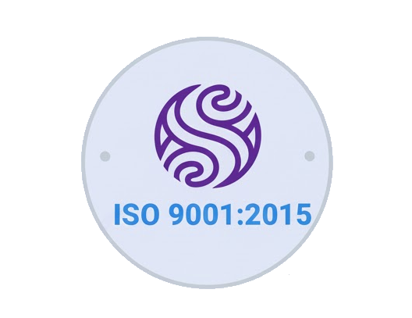
Connect with 100's of platforms
We integrate powerful AI tools directly into your existing ecosystem. Automate tasks and unify data without leaving your favorite apps.
CRM Connected
WhatsApp
Instagram
Messenger
Slack
Custom integrations
Advanced custom API / webhook integration
Shopify
HubSpot
Salesforce
Stripe
One-Click Connectors
Instant setup for major platforms.
Automation Triggers
Real-time actions across apps.
Google
Calendly
Mailchimp
100+ More
Secure Data Sync
Enterprise-grade encryption & privacy, meeting SOC 2, GDPR, HIPAA, and ISO to ensure data is always secure.
99.9% Uptime
SEAMLESS INTEGRATIONS

Slide 8


Built Around Your Unique Products
Your Data
We don't just plug in generic AI. We integrate our proprietary LLM solutions deeply tailored to your specific inventory, brand voice, and business rules for maximum relevance.
Proprietary Set
Output
Fine-Tuned Precision
Custom Model
Fine-tuned
Secure
Models trained on your actual data and guardrails to understand your products perfectly.
Deep Domain Context
Product Info
SKUs & Specs
Enhanced with prompt engineering and evaluation loops specific to your industry needs.
Secure & Compliant
Enterprise-grade integration that keeps your proprietary data safe and compliant.
ADAPTABLE AI MODELS

Slide 9


AI SALES & SUPPORT
Engage & Convert 24/7 Worldwide.
🇺🇸
Hello!
Deploy multi-language intelligent assistants that never sleep. Deliver proactive outreach and real-time support to drive revenue and customer satisfaction simultaneously.
🇩🇪
Hallo
Multi-Language Fluency
🇫🇷
Bonjour
Seamlessly communicate with global customers in their native language with cultural nuance.
Proactive Engagement
🇪🇸
¡Hola!
Initiate conversations based on user behavior to guide them through the sales funnel automatically.
Consistent Brand Voice
Ensure every interaction aligns with your brand identity while providing accurate, compliant responses.

Slide 10






TRANSFORMATION AWAITS
What are you still waiting for?
Ready to unlock the full potential of AI for your business?
Let’s build intelligent solutions that deliver real results.
Save Time
Cut Costs
Accelerate Growth
Automate 80% of repetitive workflows.
Reduce operational overhead significantly.
Scale revenue without scaling headcount.
Book a Strategy Call
Ezequiel Sznaider - CEO
eze@massapro.com
massapro.com

